Slide 1

ETEC-303 Digital Communication Lecture - 4
Instructor:
Abhishek Gagneja
Digital Communication Slides

Slide 2
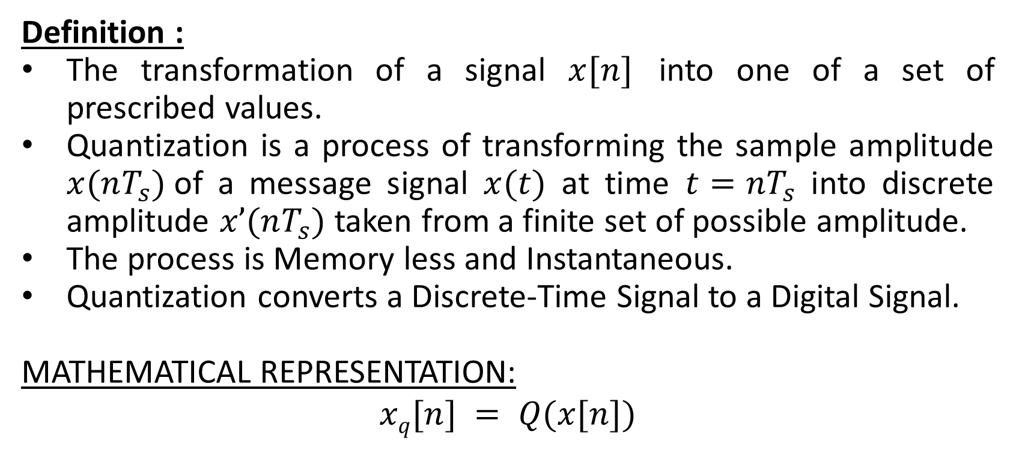
Quantization
Definition :
The transformation of a signal $x[n]$ into one of a set of prescribed values.
Quantization is a process of transforming the sample amplitude $x(nT_{s})$of a message signal $x(t)$ at time $t=nT_{s}$ into discrete amplitude $x’(nT_{s})$ taken from a finite set of possible amplitude.
The process is Memory less and Instantaneous.
Quantization converts a Discrete-Time Signal to a Digital Signal.
MATHEMATICAL REPRESENTATION:
$$xq[n] = Q(x[n])$$
Digital Communication Slides

Slide 3
3
x(t)
2
1
0
t
Consider the analog Signal x(t).
Digital Communication Slides

Slide 4
x[n]
3
2
1
0
n
The signal is first sampled
Digital Communication Slides

Slide 5
3
2
1
0
n
Digital Communication Slides

Slide 6
3
2
1
0
n
Digital Communication Slides

Slide 7
3
2
1
0
n
Sample
Digital Communication Slides

Slide 8
3
2
1
0
And Hold
n
Digital Communication Slides

Slide 9
3
2
1
0
n
Digital Communication Slides

Slide 10
3
Assign Closest Level
2
1
0
n
Digital Communication Slides

Slide 11
3
2
1
0
n
Digital Communication Slides

Slide 12
3
2
1
0
n
Digital Communication Slides

Slide 13
3
2
1
0
n
Digital Communication Slides

Slide 14
3
2
1
0
n
Digital Communication Slides

Slide 15
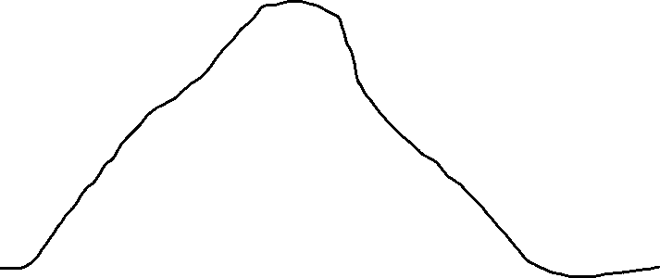
3
2
1
0
n
0 1 2 3 4 3 2 1 0
000 001 010 011 100 011 010 001 000
Digital Communication Slides

Slide 16
x(t)
3
2
Original Signal
1
0
t
Digital Communication Slides

Slide 17
x~(t)
Quantized Signal
3
2
1
0
t
It is quite apparent that the quantized signal is not exactly the same as the original analog signal. There is a fair degree of quantization error here. However; as the number of quantization levels is increased the quantization error is reduced and the quantized signal gets closer and closer to the original signal
Digital Communication Slides

Slide 18
x~(t)
Quantized Signal
0
t
It is quite apparent that the quantized signal is not exactly the same as the original analog signal. There is a fair degree of quantization error here. However; as the number of quantization levels is increased the quantization error is reduced and the quantized signal gets closer and closer to the original signal
Digital Communication Slides

Slide 19
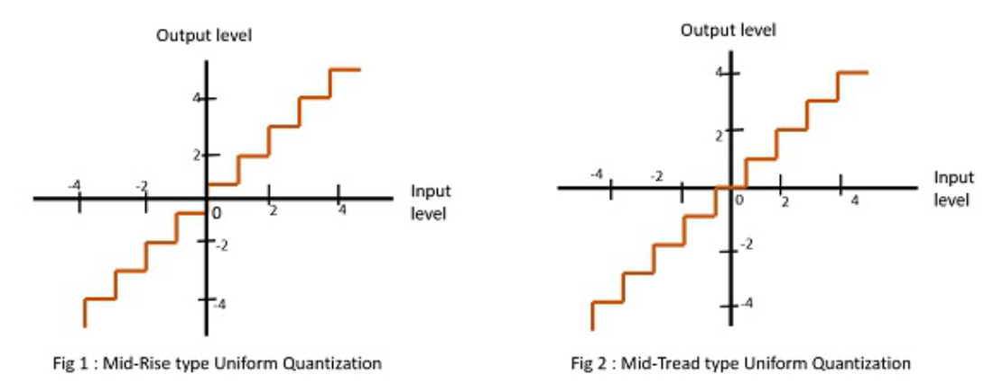
Types of Quantization: Uniform Quantization
Digital Communication Slides

Slide 20
Types of Quantization: Uniform Quantization
Figure 1 shows the mid-rise type and figure 2 shows the mid-tread type of uniform quantization.
The Mid-Rise type is so called because the origin lies in the middle of a raising part of the stair-case like graph. The quantization levels in this type are even in number.
The Mid-tread type is so called because the origin lies in the middle of a tread of the stair-case like graph. The quantization levels in this type are odd in number.
Both the mid-rise and mid-tread type of uniform quantizers are symmetric about the origin.
Digital Communication Slides

Slide 21
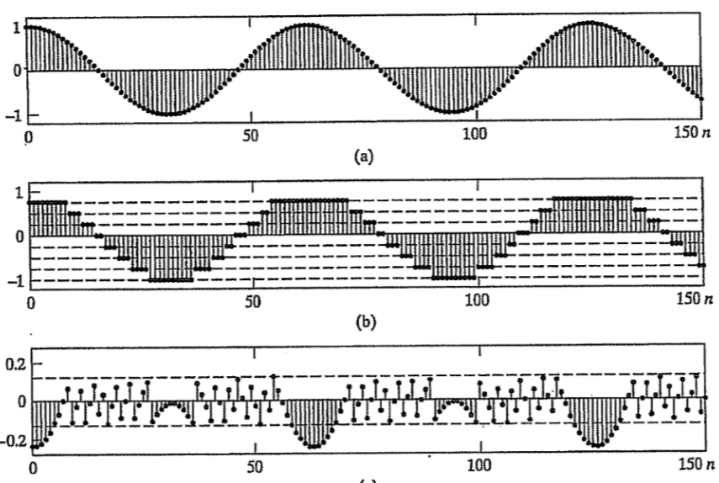
Quantization
(a) Unquantized samples of x[n] = 0.99cos(n/10). (b) with a 3-bit quantizer. (c) corresponding Quantization error sequence
Digital Communication Slides

